Slide 1
OpenChain: Our Legacy
What we did, what it means, and where we are going next

Slide 2
OpenChain Vision + Mission
Our vision is a trusted supply chain and our mission is to make that happen.
We create trust by improving compliance process management. We started with license compliance and expanded into security compliance.
Our standardized approaches reduce risk, reduce costs and increase speed.
Everything we do – standards, community and reference material – serves our purpose and our mission.
Project Charter: https://github.com/OpenChain-Project/Project-Charter-And-Agreements/blob/master/Project-Charter/OpenChain-Charter-March2020.pdf

Slide 3
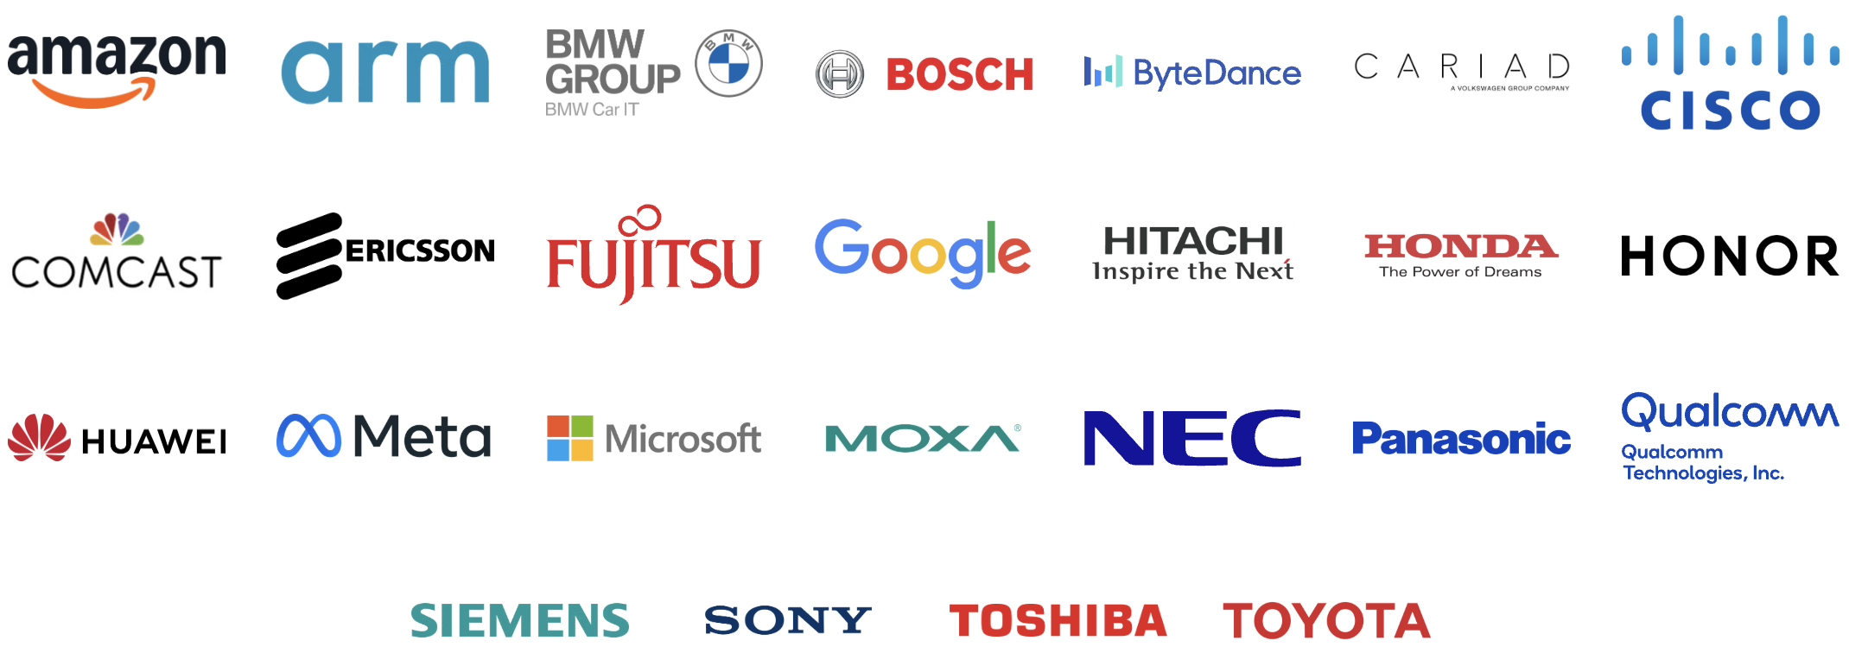
Platinum Members (Governing Board)
Members Represent Trillions In USD Market Value

Slide 4




High Level Solution – Process Approach
Process Management Standards
Implementation Standards
Methods

Slide 5
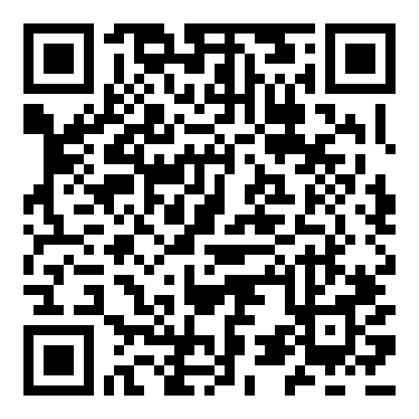
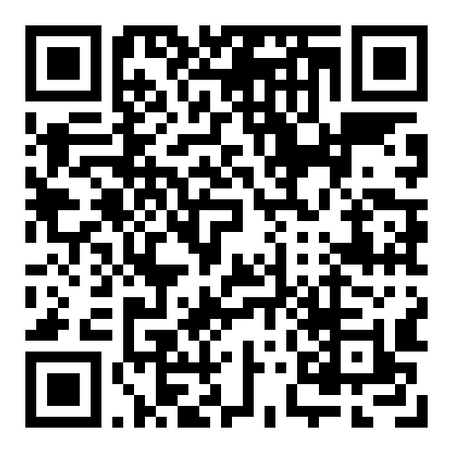
Trust Built By Process Management
OpenChain ISO/IEC 5230:2020 International Standard for open source license compliance.
OpenChain ISO/IEC 18974:2023 International Standard for open source security assurance.
High level process standards
Simple, effective and suitable for companies of all sizes in all markets
Openly developed by a vibrant user community and freely available to all

Slide 6
A Few Days Ago…
At The Linux Foundation Member Summit

Slide 7
When Should We Make Standards?

Slide 8
A Talk About Standards That Pre-Date the United States
By a considerable margin

Slide 9
It Illustrated Everything Good and Bad About Standardization *
* Not An Accurate Statement

Slide 10
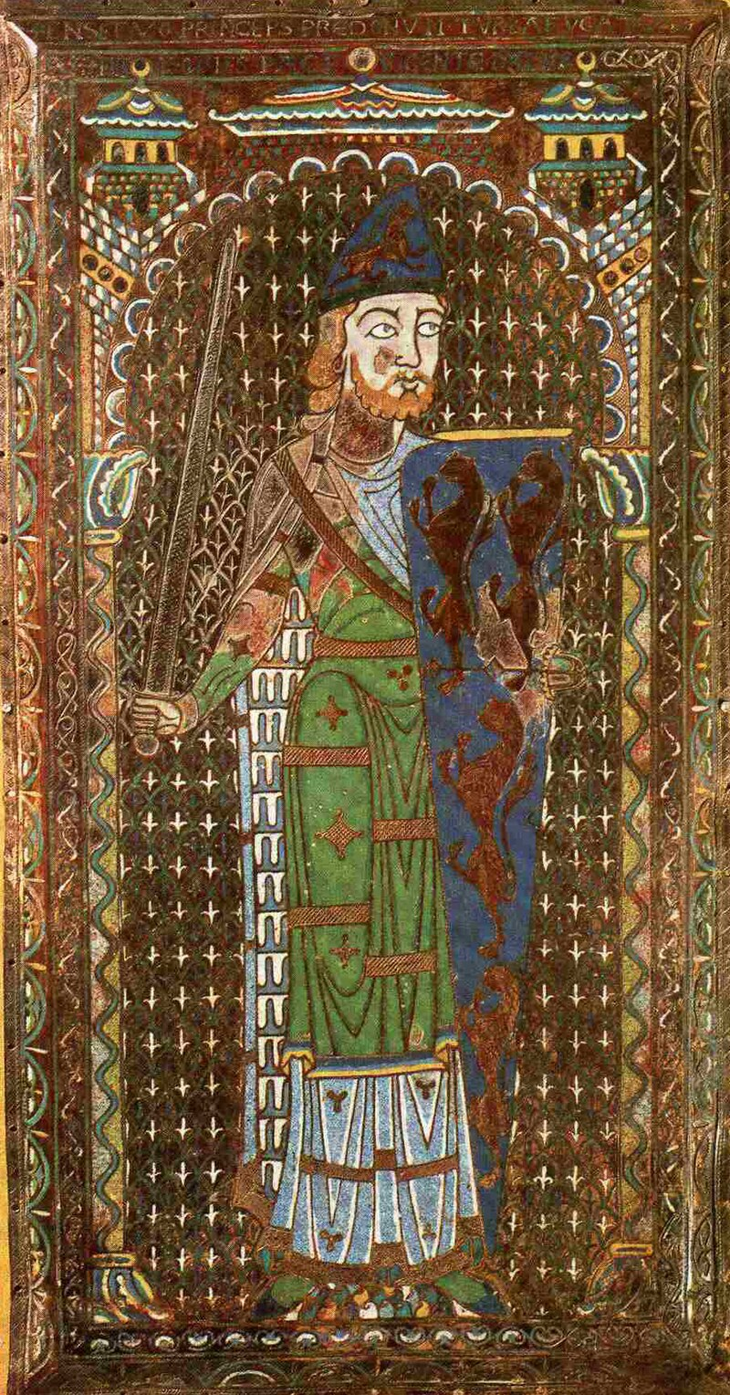
Hereldry in France and England
Perhaps the first incident of modern heraldry is the tomb of Geoffrey Plantagenet, Count of Anjou (d. 1151). It shows him holding a blue shield with six golden lions.
In 1484, during the reign of Richard III, the various heralds employed by the crown were incorporated into England's College of Arms, through which all new grants of arms would eventually be issued

Slide 11

Hereldry – Specific Example
John Óg MacCoghlan, 16th Century (the time of Henry VIII and Queen Elizabeth)
The English heraldry rules were used for domains under English control
Until 1922 Ireland was part of the United Kingdom *
* They still keep a bit of North Ireland as a souvenir

Slide 12
Result: Everyone Gets A Shield *
* Not Even Remotely True

Slide 13
But Wait! A Problem!
In the 17th century, Swedish Intervention in the Thirty Years' War involved Galloglass (gallóglaigh - Scottish Mercenaries)
Scotland mostly used English heraldry rules as part of the United Kingdom
Sweden justifiably irrationally used Swedish heraldry rules
Notes:
https://www.amazon.com/Galloglass-1250-1600-Gaelic-Mercenary-Warrior/dp/1846035775
https://en.wikipedia.org/wiki/Gallowglass
https://www.electricscotland.com/history/sweden/17-1.htm
https://www.jstor.org/stable/j.ctt6wp6pg.9?seq=9

Slide 14

Conflicting Standards
! =
Ramfelt by Dan Koehl, CC BY 3.0

Slide 15
Heraldry rule confusion for Scottish warriors in Sweden

Slide 16
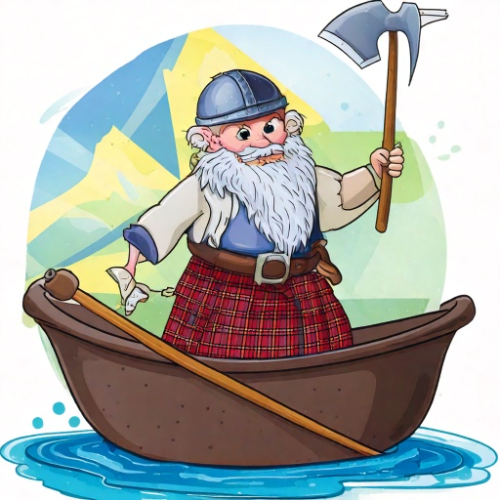
Solution: Unclear. Leave In A Bad Mood? 🤷

Slide 17
Anyway
The point of that talk was…

Slide 18
Standards Have Existed For A Long Time
They play an important role in formalizing something important to people
They are imperfect because humans are imperfect
Sometimes different people have different ideas of what’s the right standard

Slide 19
Open Source Is Getting Good At Standards
We are increasingly using other sector’s standards (good)
We are building new standards where there are gaps (good)
Sometimes we get excited about what else can be standardized (good with provisos)

Slide 20
OpenChain Helps Understand + Build Standards
✅ Is there a problem?
✅ Is there something we can do about the problem?
✅ Does everyone need to do the same thing for an optimal solution?
❌ Will a guide be enough?
❌ Will a technical document be enough?

Slide 21
We Have Built Two Of The Most Important
ISO/IEC 5230 (License Compliance)
ISO/IEC 18974 (Security Assurance)
Flexible program size
Covering:
Inbound processes
Internal processes
Outbound processes
Standards about process points
Not about process content

Slide 22
That Is Not All We Do
OpenChain has accomplished much more than simply writing standards

Slide 23
OpenChain Is Very Good At Community

Slide 24
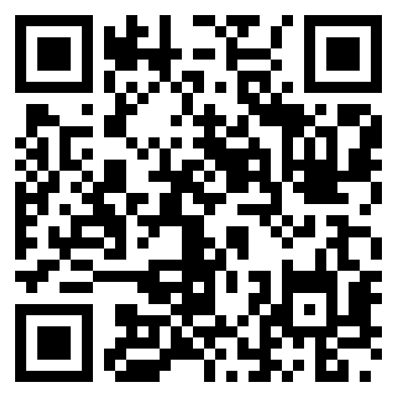
We Have Community Study and Work Groups
Core Work Groups
Education (Autumn 2020~)
Specification (Spring 2016~)
Community Work Groups
AI (January 2024~)
Automation (Summer 2019~)
Community Study Groups
SBOM (July 2024~)
Industry-Specific Work Groups
Automotive (Summer 2019~)
Telecom (Spring 2021~)
Regional User Groups
China (Sept 2019~)
Germany (Jan 2020~)
India (Sept 2019~)
Japan (Dec 2017~)
Korea (Jan 2019~)
Taiwan (Sept 2019~)
UK (June 2020~)

Slide 25
Everyone Is Welcome To Drop In
Our calls are open and publicly listed.
We provide access to work groups, special interest groups and local work groups via mailing lists.
We also use Slack and WeChat.
You can just turn up and ask questions.

Slide 26
OpenChain Is Very Good At Sharing Reference Material

Slide 27
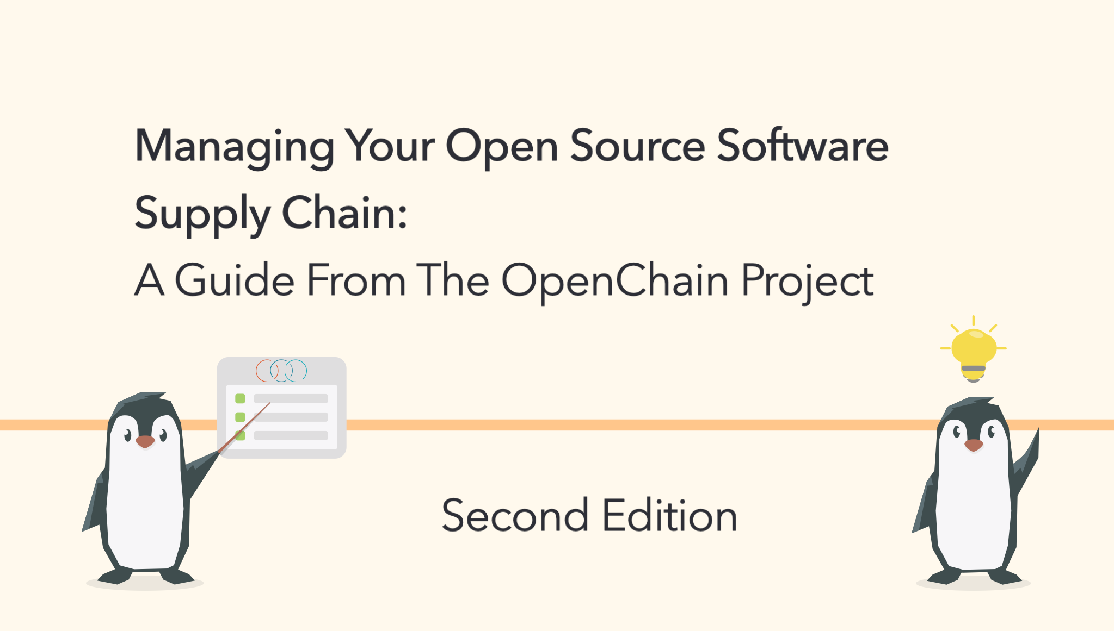
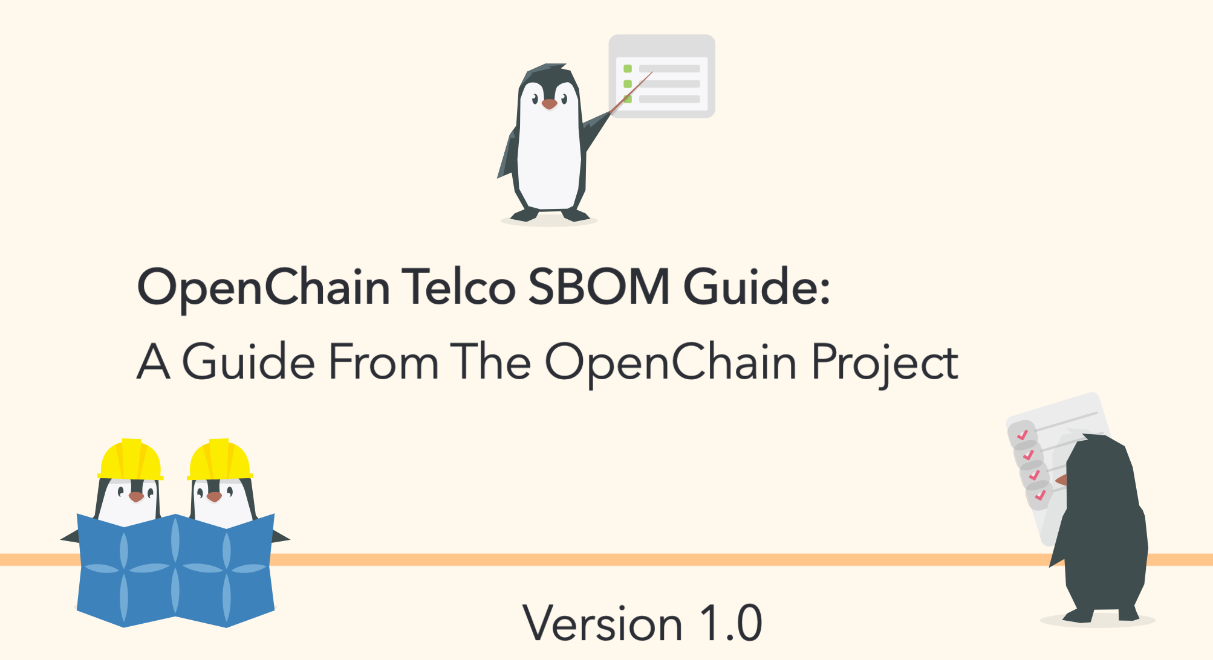
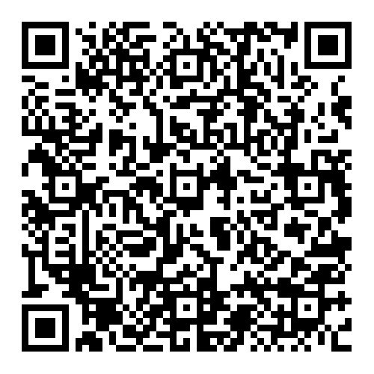
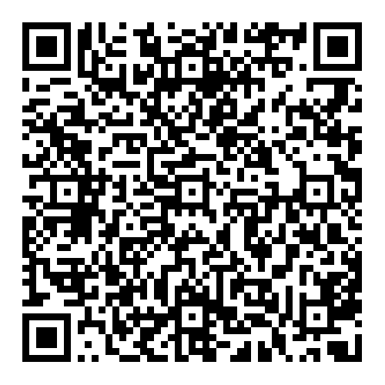
Guides

Slide 28

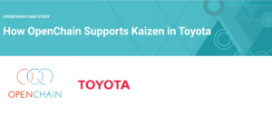
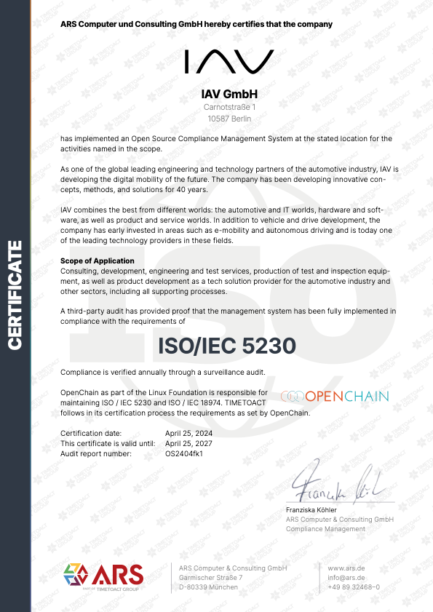
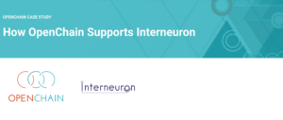

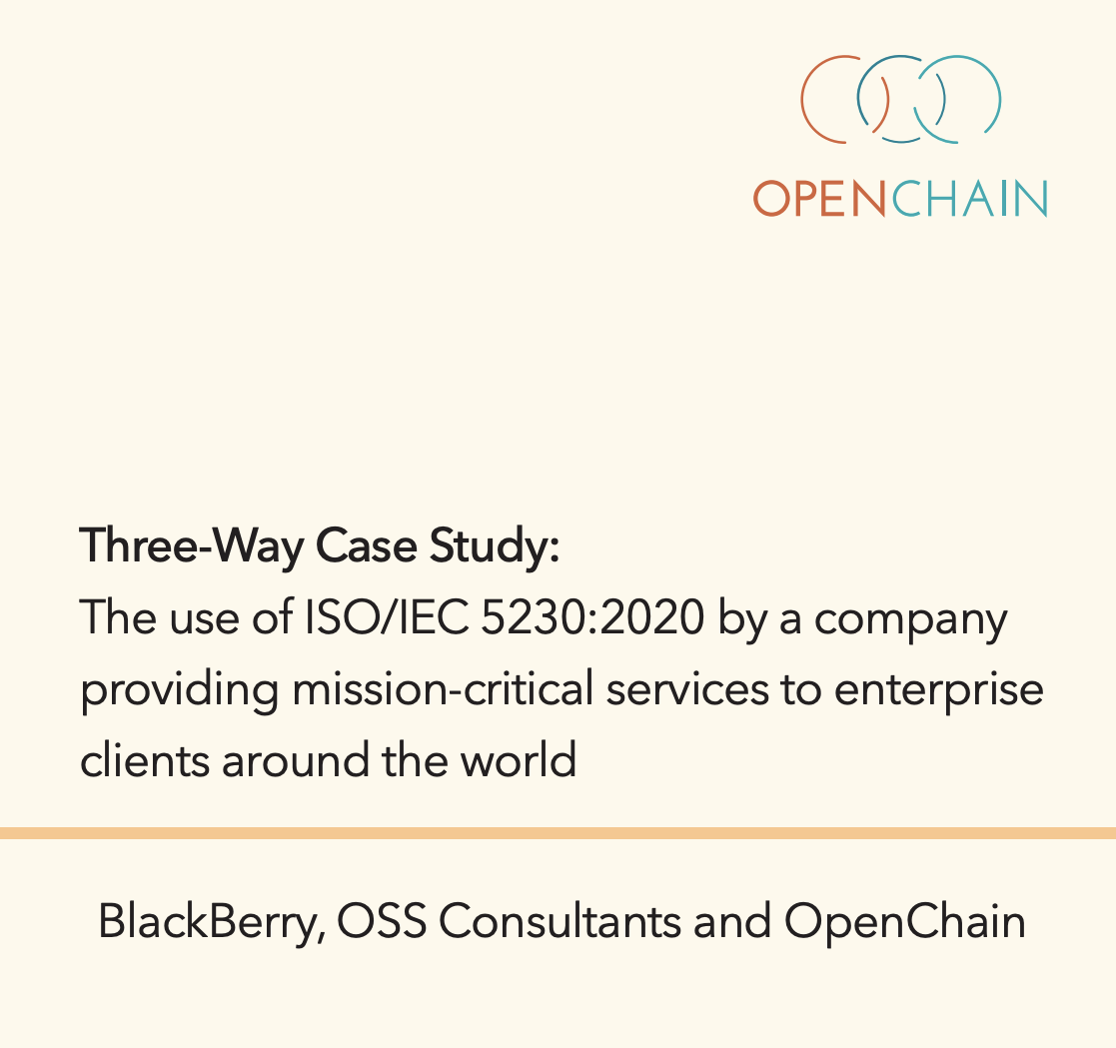
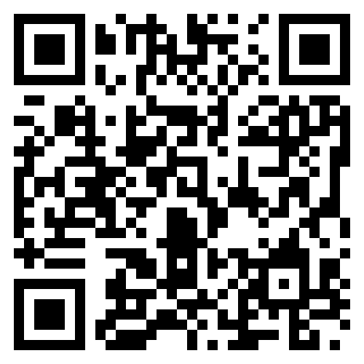
Case Studies

Slide 29
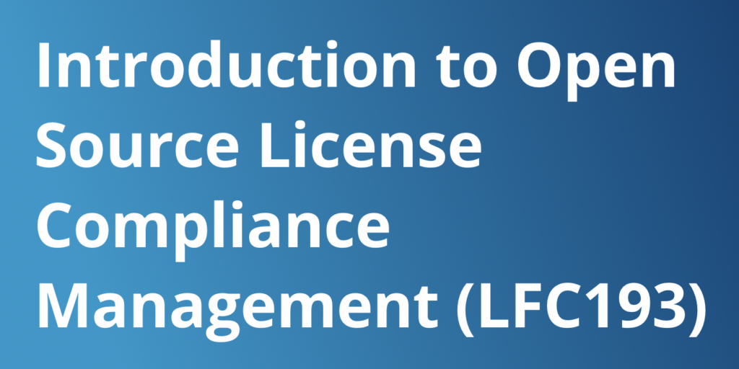
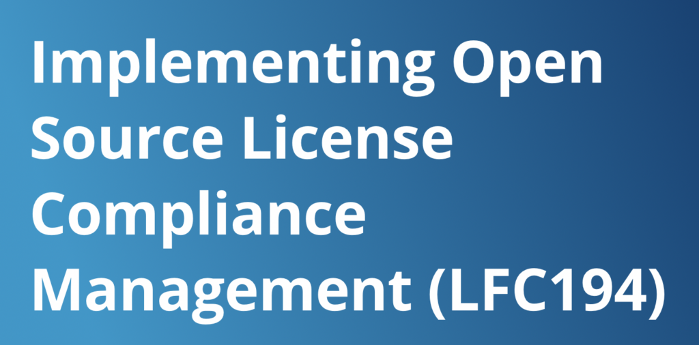
Training Courses

Slide 30
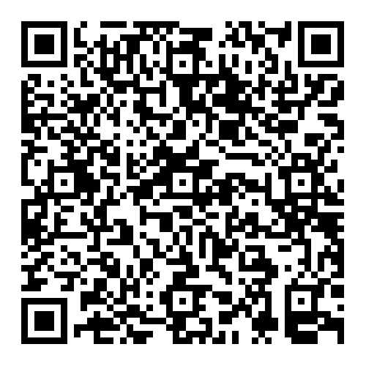
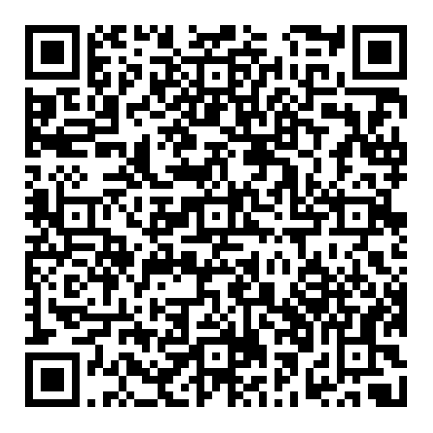
Our Newest Releases Are Increadible
Capability Model / Maturity Model Inter-Department Explainers
Insanely Valuable
Insanely Useful

Slide 31
But What Does This All Mean?

Slide 32
What Is Our Legacy?

Slide 33
A Family Legacy
Eocu Mor founded the Ui Eachac Clans circa 475
⏎ Criomtann ⏎ Laogaire ⏎ Clairineac
⏎ Sealbac ⏎ Cochlan
(…)
John Óg MacCoghlan, 16th Century
(…)
Great Grandfather William Coughlan, Lt Cdr. Royal Navy ⏎ Grandfather Kevin Coughlan, government official
⏎ To Be Determined (TBD)

Slide 34
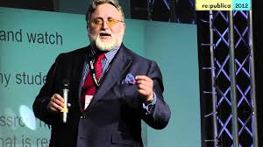
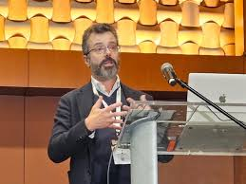
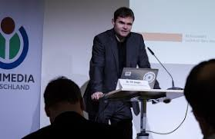
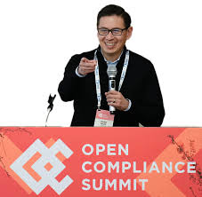
An Industry Legacy
1986: Free Software Definition – First modern definition
1991: GPLv2 License – First modern license
1998: Open Source Definition – First widely accepted definition
2007: GPLv3 License – First globally drafted license
2016: OpenChain Specification 1.0 – First formal license management specification
2020: ISO/IEC 5230 license process management begins to be formalized in ISO standards
2023: ISO/IEC 18974 adds security management

Slide 35

A Path Towards Trust And Better Collaboration
2023
2020
2016
1998
2007
1991
1986
Less Trust
More Trust

Slide 36
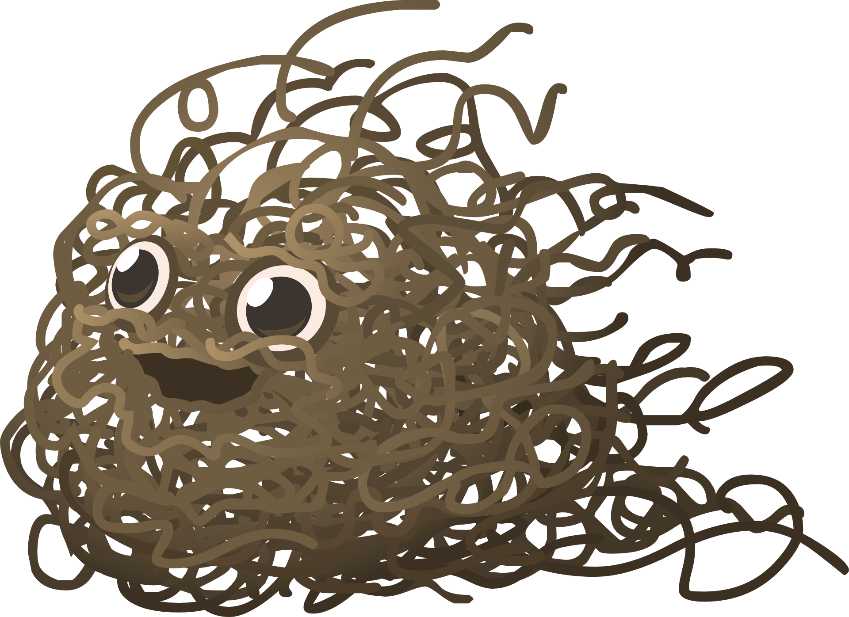
Formal Processes
You did this

Slide 37
The OpenChain Community Leads Industry Evolution

Slide 38
Let’s Return To Now, Korea – 25th March

Slide 39
We Are Not Done…

Slide 40
There Are More Challenges Than Ever
How do we deal with all the new regulations like NTIA and CRA?
How do we deal with emerging technology like AI?
What is a good SBOM anyway?
Do we need more standards?
How do we make it less confusing?
…?

Slide 41
Help Build The Future
Let’s Make The Newest Challenges Easy To Manage

Slide 42
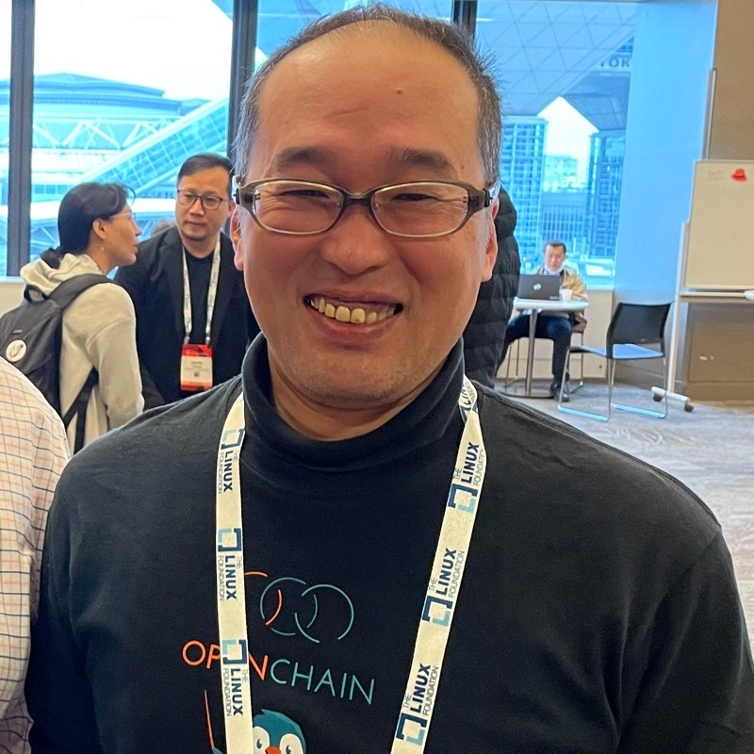
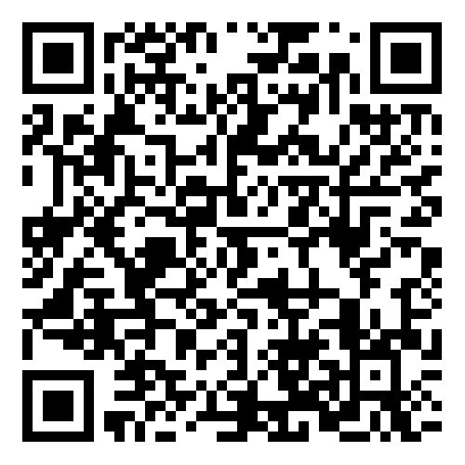
SBOM Study Group
Considering Cross-Industry / Cross-Format SBOM Quality Guide for the Supply Chain
Guide release ETA: Q3 2025
Feb 2025 Meeting

Slide 43
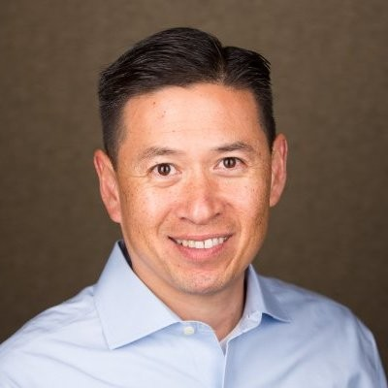
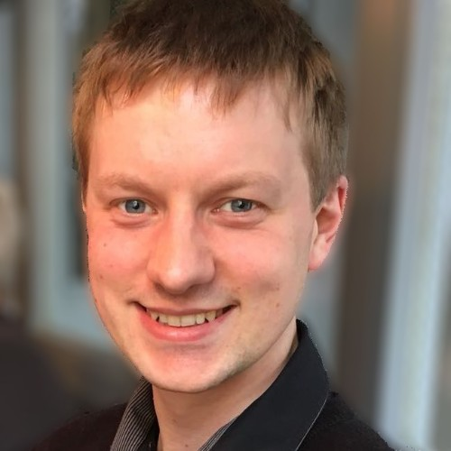
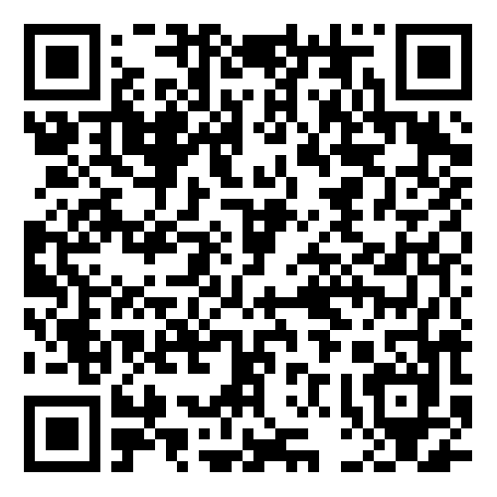
AI Work Group
Finalizing a guide to AI BOM Compliance in the Supply Chain
Guide release ETA: Q2 2025
March 2025 Meeting

Slide 44

This Could Be You:
✅ Productive
✅ Helpful
✅ Super Wise
✅ Celebrated
✅ The Most Popular Person At Parties

Slide 45
More Seriously…

Slide 46
Let’s Keep Making Things Better

Slide 47
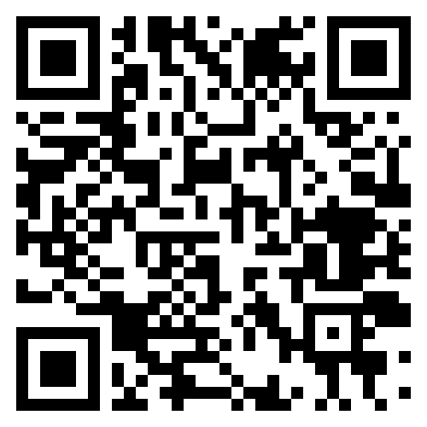
Contact Me Anytime About Anything
Shane Coughlan
scoughlan@linuxfoundation.org +81 80 4035 8083

